Slide 1
Separating Soluble Substances
Year 7 Science

Slide 2
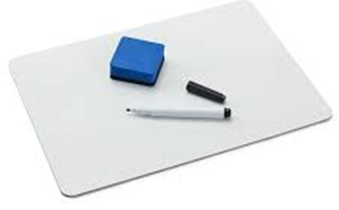
Review:
List as many physical properties as you can.
Which property does gold panning depend on?
Which property does sieving depend on?
Which property does a centrifuge depend on?
Draw the equipment required for filtration.

Slide 3
Learning Intentions
Mixtures, including solutions, contain a combination of pure substances that can be separated using a range of techniques.

Slide 4
Success criteria
Describe chromatography as a technique for separating soluble substances.
Compare mixtures of food dyes.

Slide 5
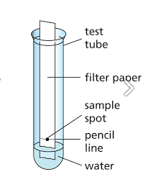
Activity 1: Paper chromatography

Slide 6


Slide 7
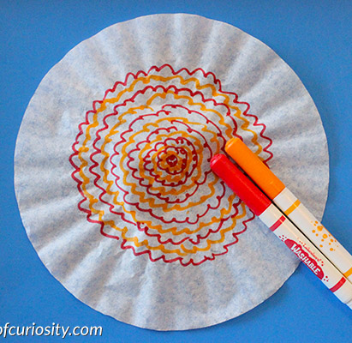
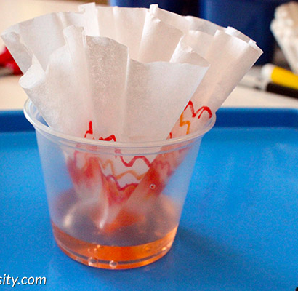
Activity 2: Filter paper chromatography art

Slide 8
Success criteria
Describe chromatography as a technique for separating soluble substances.
Compare mixtures of food dyes.

